Slide 1
1090514 演練課

Slide 2

109 05 20(三) 第二次期中考
時間：109.05.20 15:30～17:20
要到學校考，會多借一間教室 (到時會公布)
範圍：ch8～9
滿分也是120

Slide 3
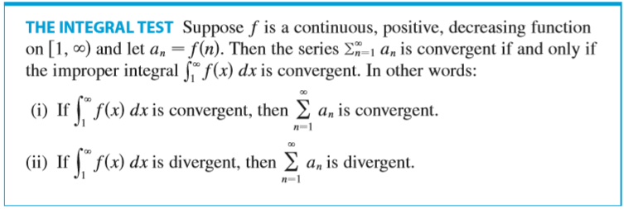


Slide 4



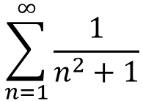

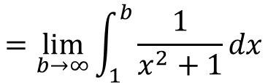


$$\sum_{n=1}^{∞}{\frac{1}{n^{2}+1}}$$
Is convergent or divergent?
positive
$$\int_{1}^{∞}{\frac{1}{x^{2}+1}}dx$$
continuous
dicreasing
$$=\lim_{b→∞}{\int_{1}^{b}{\frac{1}{x^{2}+1}}dx}$$
$$=\lim_{b→∞}{{{(tan}^{−1}x)}_{1}^{b}}$$
$$=\lim_{b→∞}{(\tan^{−1}b−\tan^{−1}1)}$$
$$=\frac{π}{2}−\frac{π}{4}$$
$$=\frac{π}{4}$$

Slide 5
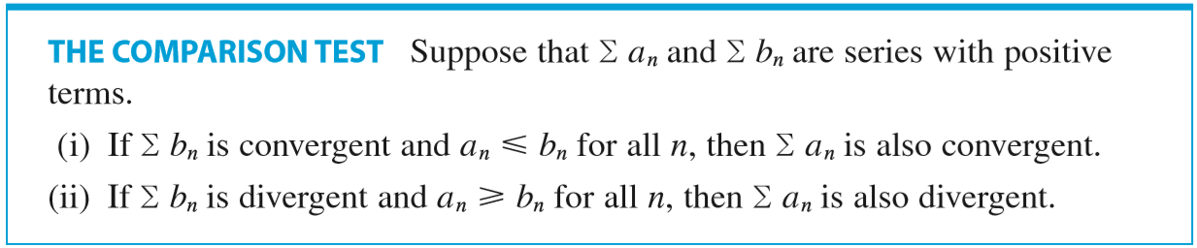

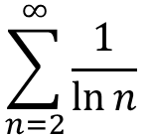


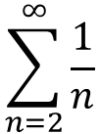
$$\sum_{n=2}^{∞}{\frac{1}{\ln{n}}}$$
$$\sum_{n=2}^{∞}{\frac{1}{\ln{n}}}$$
Is convergent or divergent?
$$\sum_{n=2}^{∞}{\frac{1}{n}}$$
$$>$$
Is divergent
$$∴by the comparison test\left(ii\right)$$
$$\sum_{n=2}^{∞}{\frac{1}{\ln{n}}}$$
Is divergent

Slide 6
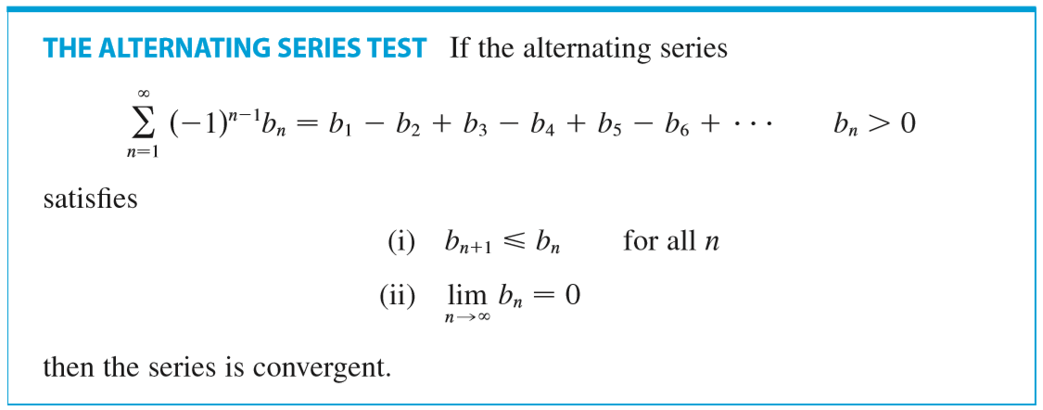

Slide 7



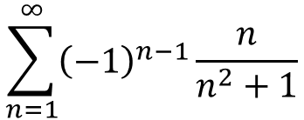

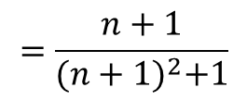
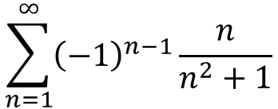


$$\sum_{n=1}^{∞}{{\left(−1\right)}^{n−1}\frac{n}{n^{2}+1}}$$
Is convergent or divergent?
$$b_{n}=\frac{n}{n^{2}+1}$$
$$=\frac{n+1}{{(n+1)}^{2}+1}$$
$$b_{n}= \frac{n}{n^{2}+1}$$
$$b_{n+1}$$
$$<$$
For all n
$$\lim_{n→∞}{b_{n}=0}$$
$$∴by the alternating series test$$
$$\sum_{n=1}^{∞}{{\left(−1\right)}^{n−1}\frac{n}{n^{2}+1}}$$
Is convergent

Slide 8



Slide 9
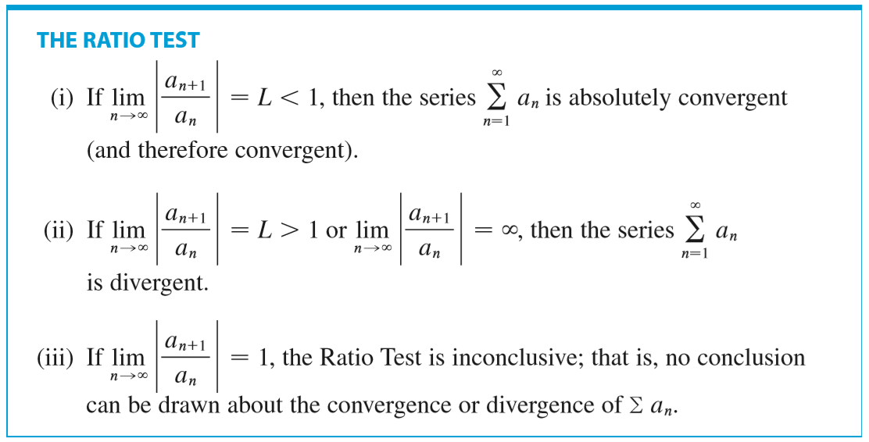

Slide 10
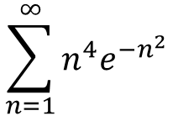


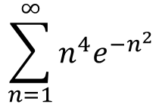

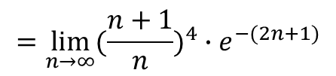
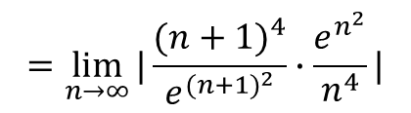
$$\sum_{n=1}^{∞}{n^{4}e^{{−n}^{2}}}$$
Is convergent or divergent?
$$L=\lim_{n→∞}{|\frac{a_{n+1}}{a_{n}}|}$$
$$=\lim_{n→∞}{|\frac{{(n+1)}^{4}}{e^{{(n+1)}^{2}}}∙\frac{e^{n^{2}}}{n^{4}}|}$$
$$=\lim_{n→∞}{({\frac{n+1}{n})}^{4}∙e^{−(2n+1)}}$$
By the ratio test
$$=0$$
$$<1$$
$$\sum_{n=1}^{∞}{n^{4}e^{{−n}^{2}}}$$
Is absolutely convergent

Slide 11
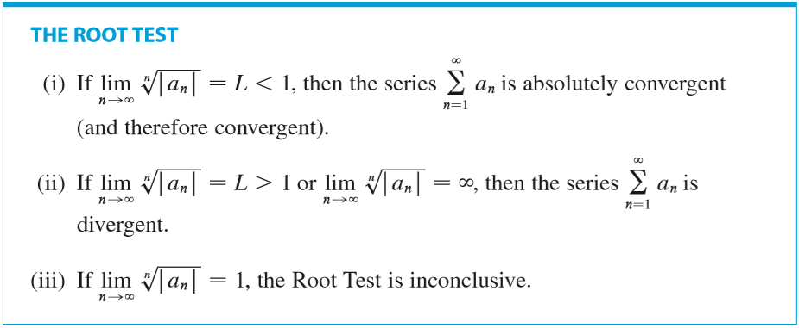

Slide 12
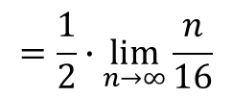

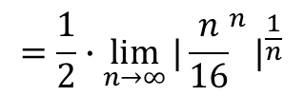
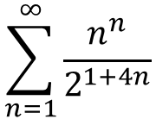
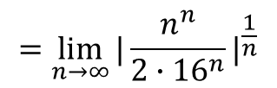
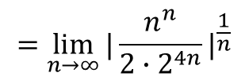
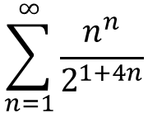
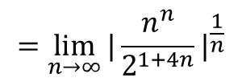

$$\sum_{n=1}^{∞}{\frac{n^{n}}{2^{1+4n}}}$$
$$=\frac{1}{2}∙\lim_{n→∞}{{|{\frac{n}{16}}^{n}|}^{\frac{1}{n}}}$$
$$L=\lim_{n→∞}{\sqrt[n]{a_{n}}}$$
$$=\frac{1}{2}∙\lim_{n→∞}{\frac{n}{16}}$$
$$=\lim_{n→∞}{{|\frac{n^{n}}{2^{1+4n}}|}^{\frac{1}{n}}}$$
$$=∞$$
$$=\lim_{n→∞}{{|\frac{n^{n}}{2∙2^{4n}}|}^{\frac{1}{n}}}$$
By the root test
$$=\lim_{n→∞}{{|\frac{n^{n}}{2∙{16}^{n}}|}^{\frac{1}{n}}}$$
$$\sum_{n=1}^{∞}{\frac{n^{n}}{2^{1+4n}}}$$
Is divergent

